Slide 1
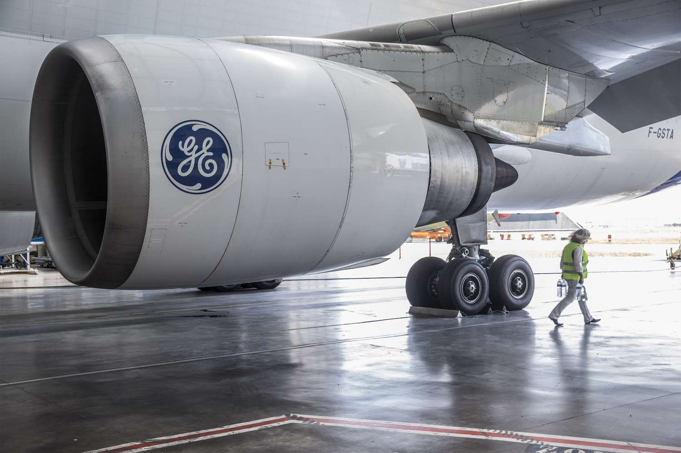
Airline Customer Service Analysis
Predicting Airline Passenger Satisfaction Using Machine Learning: A Data-Driven Approach to Enhancing Customer Experience.
In the competitive airline industry, understanding customer satisfaction is essential for improving service quality and retaining loyal passengers. This project aims to develop a machine learning model that predicts whether a customer is "Satisfied" or "Neutral/Unhappy" based on various factors including demographic details, travel characteristics, and service-related ratings such as booking ease, inflight service, cleanliness, entertainment, and more. By identifying the key drivers of satisfaction, airlines can take proactive steps to enhance passenger experiences, optimize operations, and make informed, data-driven decisions to improve overall customer engagement.

Slide 2


Data Overview
1
Dataset Size
12,9880 rows and 23 columns of Airline Customer Service data.
2
Key Features
In-flight Wifi Service, On-board Service, Class , New-Travel-Gender, and New-Travel-Type.
3
Target Variable
Satisfaction :: Neutral or Dissatisfied (0)And Satisfied(1) Customer.

Slide 3
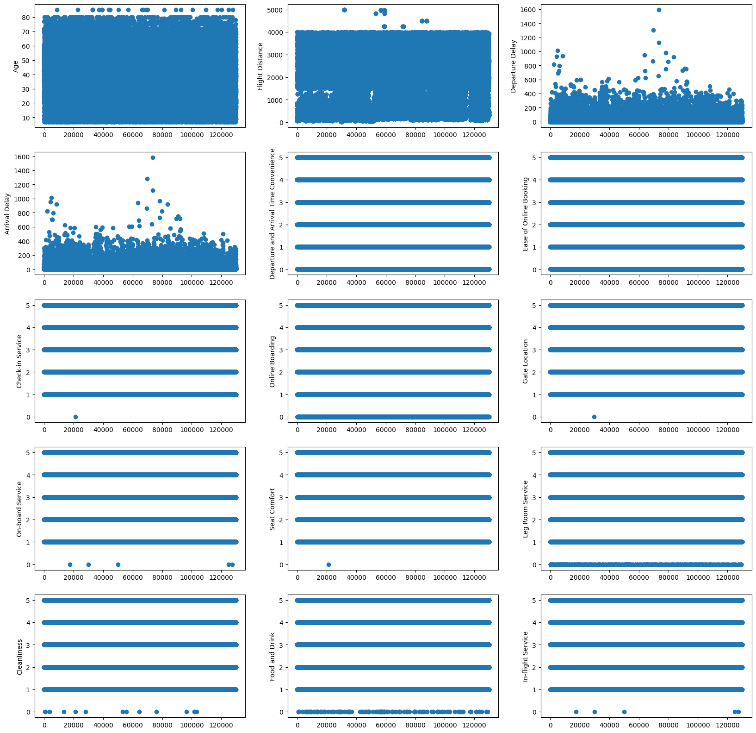
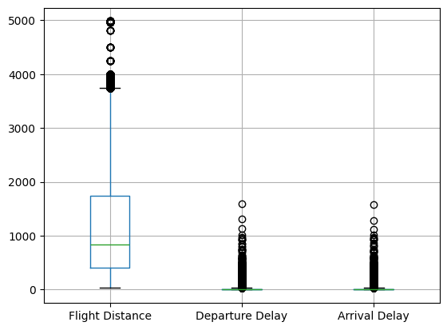
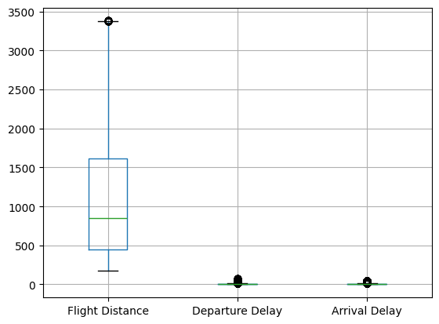
Data Preprocessing
1
Handling Missing Values
Used Isnull().sum() to find a missing values and applied fillna() and mean() to treat missing values.
Converted str to numerical data type in row by replacing “$” to empty str .
2
Outlier Treatment
Before
After
Applied Various plt to find outlier in each column and used Quantile(0.05) and Quantile(0.95) (Q1 & Q3) to Treat Outlier .
3
Feature Scaling
Standardized numerical features to ensure consistent scale across variables.

Slide 4
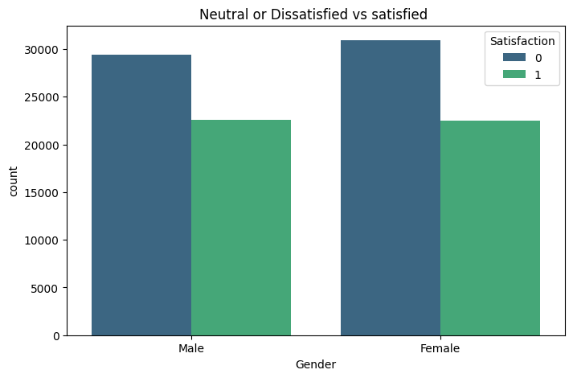
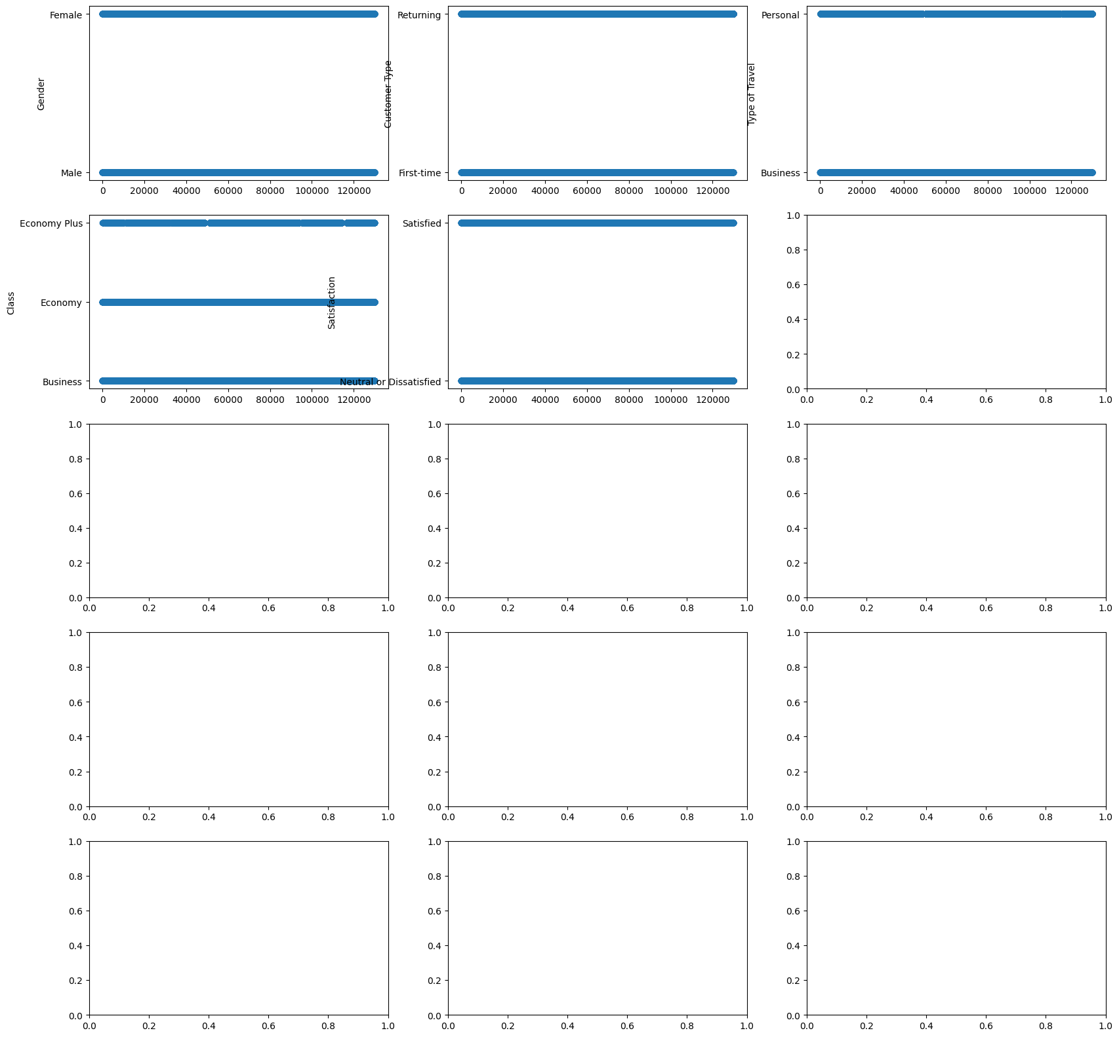
Exploratory Data Analysis
Scatter plots
Box Plots
Count Plots
Separated columns into 2 with numerical and Categorical and subplots of each columns to find relationships between features and target variable .
Box plot to display the outliers in each columns. Used boxplot to treat the outliers with (Q1 &Q3) Quantile. The plot shows before and after treatment of outlier.
Count plots is used to Display Features relationship with Target variables. by grouping both variables and displaying there mean and count with Satisfaction 0 & 1.

Slide 5
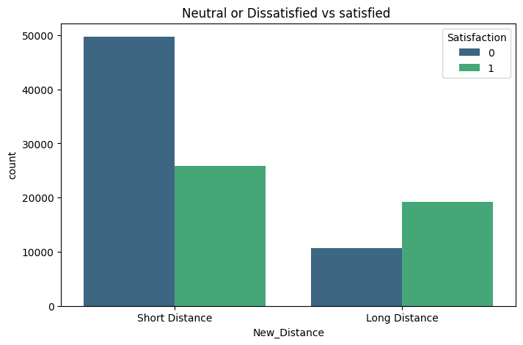
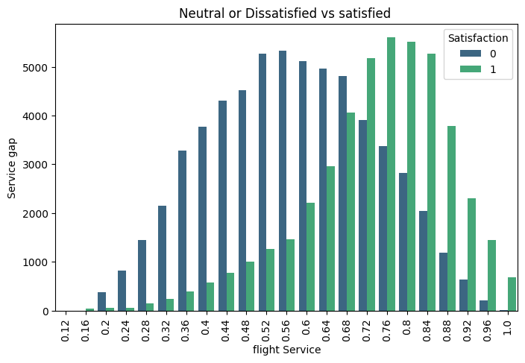
1) short Distance passenger have higher returning rate of with New_Distance with mean and count
Long Distance 0.644437 / 29885
Short Distance 0.341691 / 75539 .
This graph shows the Satisfied and Neutral or Dissatisfied customer
However the passenger in short distance flight are more dissatisfied with the flight service compared to long distance.
2) in-flight wifi service has the most significant impact on satisfaction, closely followed by Online boarding, class and in-flight entertainment. Similarly, demographic factors such as Seat Comfort and Type of Travel , Check-in Service also have significant influence on satisfaction levels. Therefore, airlines should tailor their services to target these specific customer demographics.

Slide 6
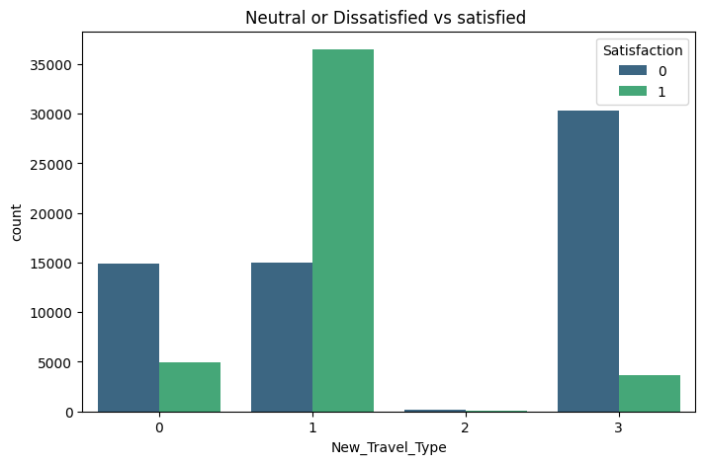
 | Satisfaction
New_Travel_Type | mean | count
Business Frist Time | 0.249154 | 19791
Business Returning | 0.708435 | 51522
Personal First-time | 0.167630 | 173
Personal Returning | 0.106370 | 33938
3) Business class passengers have higher satisfaction and loyalty, so the airline should maintain and promote the quality of premium class offerings. This includes ensuring comfortable seats, exclusive amenities, and personalized service. This statistical display shows that most travel type class of the customers are not personal or first time type traveling.

Slide 7
Model Selection
Linear Models
Tree-based Models
Advance Models
Logistic Regression has a less impact compared to other models with accuracy score of 0.87, train f1 score (0.85) and val f1 score (0.84), precision for class 0 is 0.88 and for class 1 is 0.87,recall score for class 0 is 91 and for class 1 is 0.85.
Decision Tree has low chances and Random Forest is the best model for Airline customer service with Accuracy Score of 0.96 ,precision score of 0.95 for class 0, and 0.97 for class 1 were correct, Recall Score of 0.98 for class 0, and 0.93 for class 1,and f1-scoe for train(0.99) and validation(0.95) score .
Svm model is second best model which predicted training score (0.934)and validation score(0.931),Accuracy score of (0.94) ,precision score for class 0 is 94 ,class 1 is 95 ,Recall score for class 0 is 96 , for class 1 is 92 . Satisfaction :: Neutral or Dissatisfied (0)And Satisfied(1)

Slide 8
Model Training and Evaluation
Data Splitting
Performance Metrics
80% training, 20% testing split for model evaluation.
Evaluated models using F1- score, Recall -score, Precision , Accuracy Score ,confusion matrix and confusion matrix display.
1
2
3
Hyperparameter Tuning
Used GridSearchCV to optimize model parameters.

Slide 9
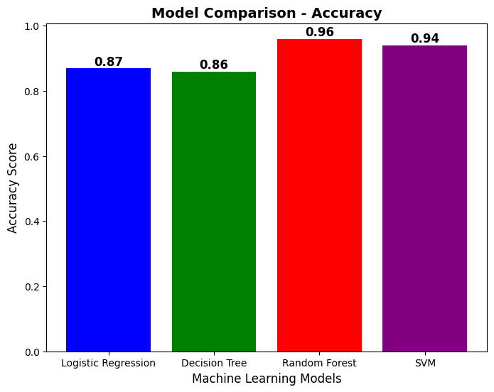
Model Performance Comparison
Best Performer
Runner-up
Baseline
Random Forest Regressor achieved highest Accuracy score of 0.96.
SVM came second with Accuracy score of 0.94.
Logistic Regression and Decision Tree performed similarly with Accuracy score around (0.86-0.87).

Slide 10
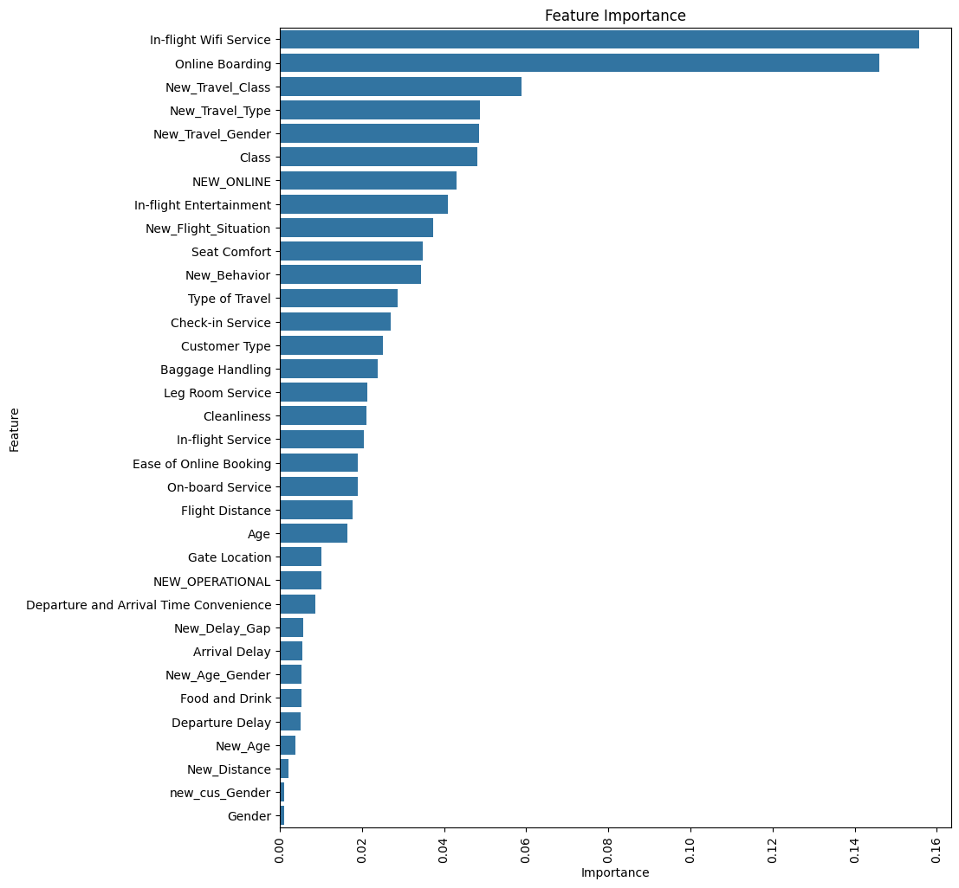



Feature Importance
In-Flight Wifi Service
Most important feature with 15.57% importance.
Online Boarding
Second most important at 14.59%.
New_Travel_Class
General and specific diffuse flows combined contribute 5.90%.

Slide 11

Key Findings
1
Best Model
Random Forest Regressor outperformed other models in predicting Airline Customer Service .
2
Important Factors
In-flight Wifi Service and Online boarding has a significantly influence over Airline Customer Service .
3
Model Accuracy
Achieved 96% accuracy in predicting Airline Customer Service.

Slide 12
THANK YOU

